Slide 1


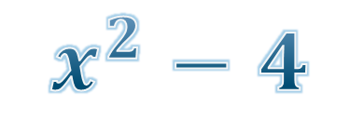



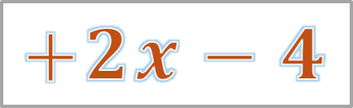



More about Factorization
$$\left(x+2\right)\left(x−2\right)$$
$$=$$
$$x^{2}−2x$$
$$+2x−4$$
$$\left(a+2\right)\left(2b−4\right)$$
$$=$$
$$x^{2}−4$$
$$=$$
$$2ab−4a$$
$$+4b−8$$

Slide 2


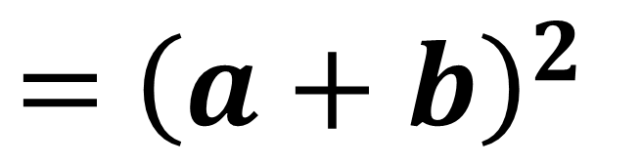

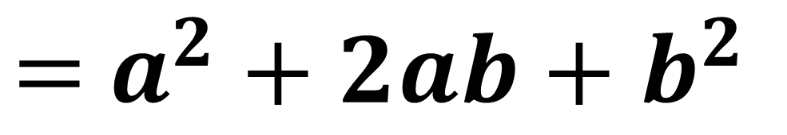




$${\left(a+b\right)}^{2}$$
$=$ ${\left(a+b\right)}^{2}$
$$\left(a+b\right)\left(a+b\right)$$
$$=$$
$$a^{2}+ab$$
$$+ab+b^{2}$$
$=$ $a^{2}+2ab+b^{2}$
$$a^{2}+2ab+b^{2}$$
$$≡$$

Slide 3

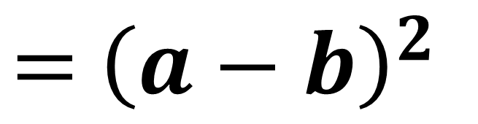

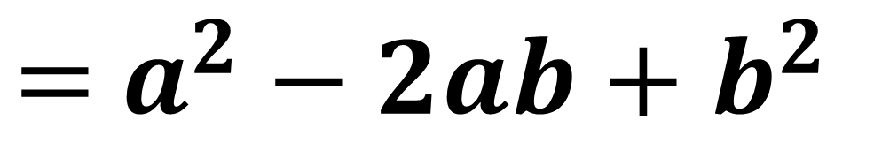
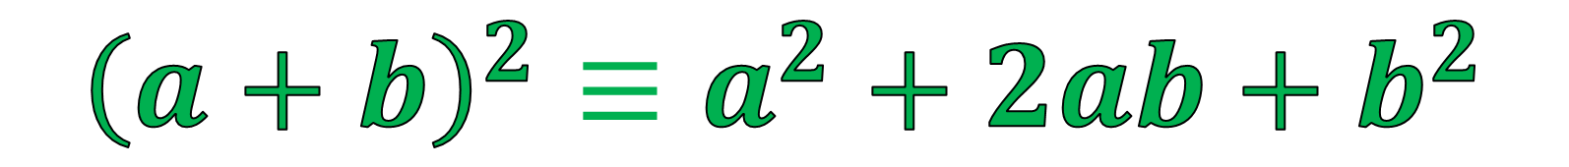



$${\left(a−b\right)}^{2}$$
$=$ ${\left(a−b\right)}^{2}$
$$\left(a−b\right)\left(a−b\right)$$
$$=$$
$$a^{2}−ab$$
$$−ab+b^{2}$$
$=$ $a^{2}−2ab+b^{2}$
$$a^{2}−2ab+b^{2}$$
$$≡$$
$${\left(a+b\right)}^{2}≡a^{2}+2ab+b^{2}$$

Slide 4

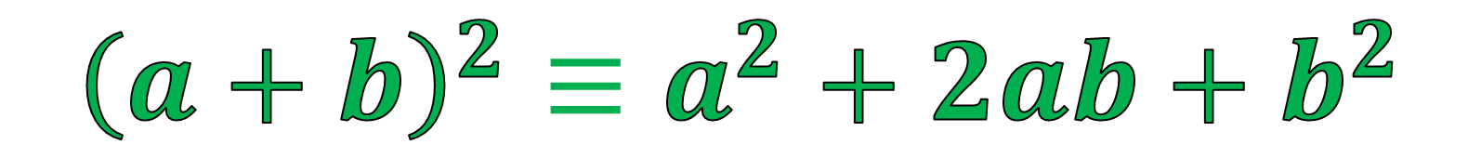


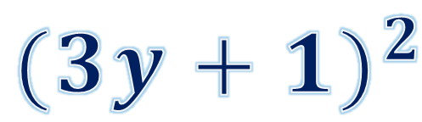



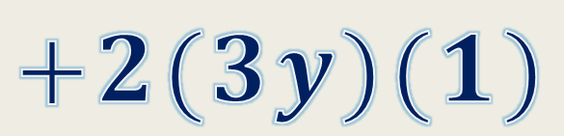
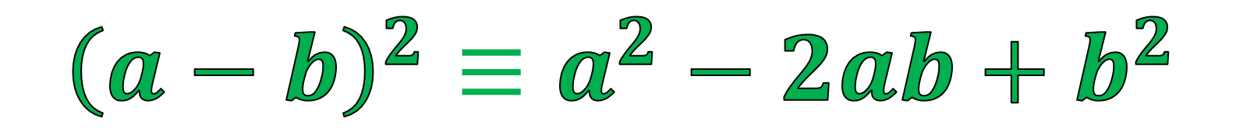

$${(3y+1)}^{2}$$
$${( a )}^{2}$$
$${(3y)}^{2}$$
$$+2(3y)(1)$$
$$=$$
$$+2( a )(b)$$
$$+{\left(b\right)}^{2}$$
$$+{\left(1\right)}^{2}$$
$$=$$
$${9y}^{2}+6y+1$$
$${\left(a+b\right)}^{2}≡a^{2}+2ab+b^{2}$$
$${\left(a−b\right)}^{2}≡a^{2}−2ab+b^{2}$$

Slide 5

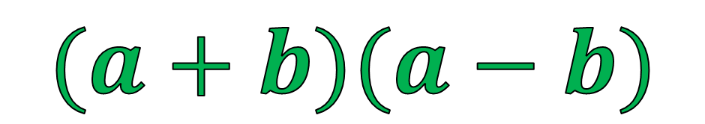






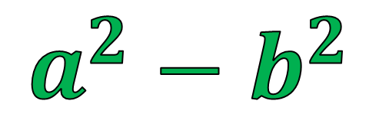






$$(a+b)(a−b)$$
$$\left(x+2\right)\left(x−2\right)$$
$$a$$
$$b$$
$$a$$
$$b$$
$$=$$
$$x^{2}−2x$$
$$+2x−4$$
$$=$$
$$x^{2}−4$$
$$=$$
$$a^{2}−b^{2}$$
$$x^{2}−2^{2}$$
$$≡$$

Slide 6
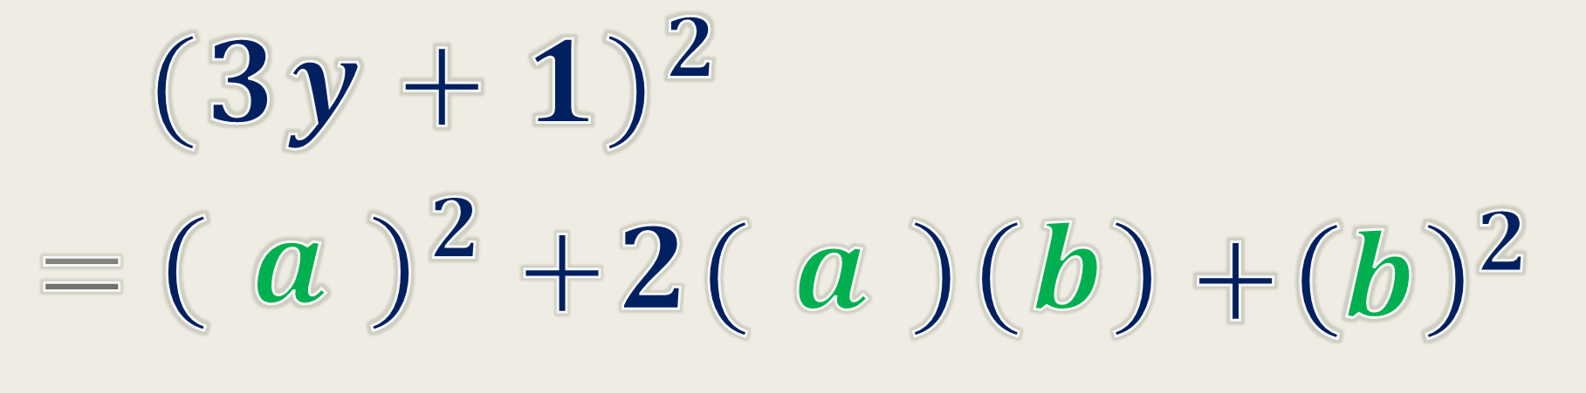
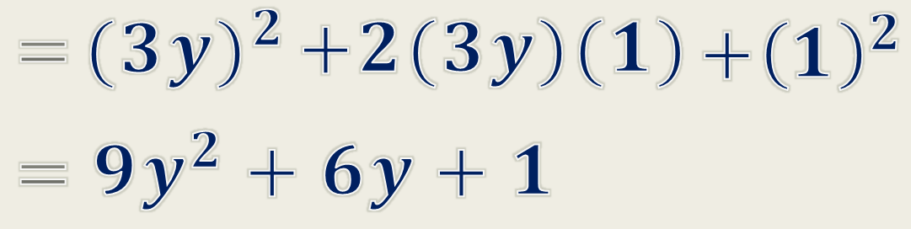

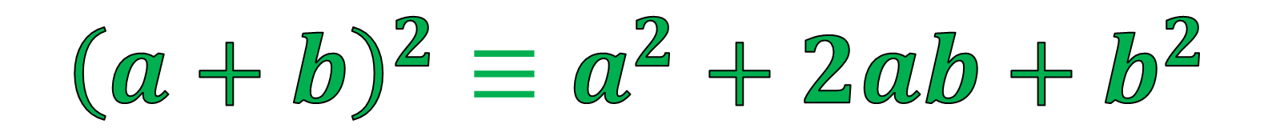

Summary
$${\left(a+b\right)}^{2}≡a^{2}+2ab+b^{2}$$
$${\left(a−b\right)}^{2}≡a^{2}−2ab+b^{2}$$
$$\left(a+b\right)\left(a−b\right)≡a^{2}−b^{2}$$

Slide 7


















Factorize the following expressions.
1. $a^{2}+4a+4$
$$=$$
(a
$$+$$
2
2)
4. $9b^{2}−6b+1$
$$=$$
$$−$$
2
(3b
1)
10. $32x^{2}−50y^{2}$
$$=$$
2
(
2
$$\text{25}\text{y}$$
2
$$\text{16}\text{x}$$
$$−$$
)
2
2
$$=$$
$$\text{(}\text{4}\text{x}\text{)}$$
$$−$$
$$\text{(}\text{5}\text{y}\text{)}$$
]
[
2
$$=$$
2 ($\text{4}\text{x}$ $+\text{5}\text{y}$) ($\text{4}\text{x}$ $−\text{5}\text{y}$)

Slide 8




















































(a)
2
$$+$$
$$\text{5}\text{x}$$
$+$ 20x
$$\text{20}$$
$$=$$
$$\text{5}$$
2
(
$$\text{x}$$
$+$4x
$$+$$
$$\text{4}$$
)
2
$$+$$
2
$$=$$
$$\text{5}$$
[
$$+$$
2
$$\text{2}$$
]
x
$\text{x}$)
(
)
(
2
2
$$=$$
(
)
$$\text{x}+\text{2}$$
$$\text{5}$$
2
2
$$+$$
)
$$−$$
$$\text{45}$$
(b)
$$+$$
$$=$$
$$\text{5}\text{x}$$
$+$ 20x
$$\text{20}$$
$$\text{5}\text{x}$$
$+$ 20x
$$\text{25}$$
(
2
$$=$$
(
)
$$\text{From} \text{(}\text{a}\text{)}$$
$$\text{x}+\text{2}$$
$$\text{5}$$
$$−$$
$$\text{45}$$
2
$$=$$
[
$$\text{5}$$
(
)
]
$$\text{x}+\text{2}$$
$$−$$
$$\text{9}$$
2
2
$$=$$
[
$$\text{5}$$
(
)
]
$$\text{x}+\text{2}$$
$$−$$
$$\text{3}$$
$$=$$
5 ($\text{x}$ $+ \text{2}+\text{3}$) ($\text{x}$ $+ \text{2}−\text{3}$)
$$=$$
5 ($\text{x}$ $+ \text{5}$) ($\text{x}$ $− \text{5}$)

Slide 9
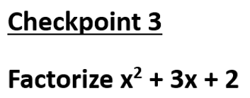
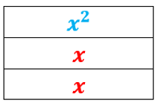
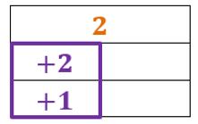
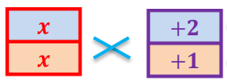













(x
$$+$$
2)
(x
$$+$$
1)
1
2
$$+$$
$$=$$
x
$$+$$
x
3
2
(x
$$+$$
2)
(x
$$+$$
1)
2
Multiply
x
$$+$$
2x
$$=$$
3x
2
$$+$$
x
$$+$$
x
3
2

Slide 10












Factorize the following expressions.
13. $x^{2}+4x+3$
$$=$$
(x
$$+$$
1)
(x
$$+$$
3)
19. $p^{2}+8pq+15q^{2}$
$$=$$
(p
$$+$$
3q)
(p
$$+$$
5q)
22. $x^{2}+17xy+30y^{2}$
$$=$$
(x
$$+$$
2y)
(x
$$+$$
15y)

Slide 11
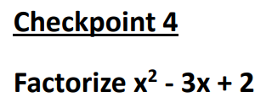
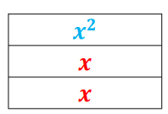
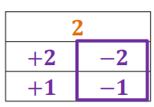
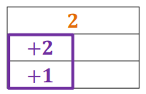
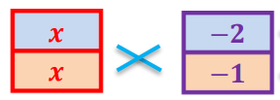












(x
$$−$$
2)
(x
$$−$$
1)
1
2
$$+$$
$$=$$
x
$$−$$
x
3
2
(x
$$−$$
2)
(x
$$−$$
1)
2
Multiply
$$+$$
$$−$$
2x)
$$=$$
$−$3x
$$−$$
x)
(
(
2
$$+$$
x
$$−$$
x
3
2

Slide 12

























Factorize the following expressions.
23. $x^{2}−14x+13$
$$=$$
(x
$$−$$
1)
$$−$$
(x
13)
30. $a^{2}−18ab+56b^{2}$
$$=$$
($\text{a}$
$$−$$
4b)
(a
$$−$$
14b)
40. $m^{2}n−10mnk+21k^{2}n$
$$=$$
$$\text{n}$$
$$−$$
$$−$$
($\text{m}$
3k)
(m
7k)
46. $x^{4}−16x^{2}y^{2}+63y^{4}$
2
2
2
2
$$=$$
$$−$$
$$−$$
($\text{x}$
7y )
(x
9y )
$$=$$
2
2
$$−$$
($\text{x}$
7y )
$$+$$
(x
3y)
$$−$$
(x
3y)

Slide 13
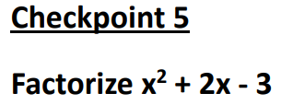
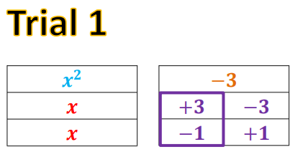


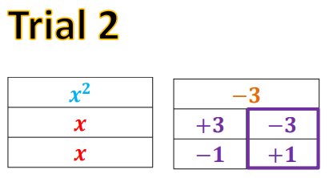


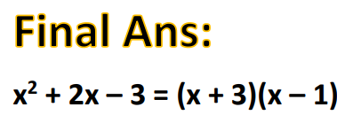













1
2
Multiply
$$−$$
x)
$$+$$
$$=$$
2x
(
3x
2
$$+$$
x
$$+$$
x
2
2
1
2
Multiply
$$−$$
x)
$$+$$
$$−$$
3x)
$$=$$
$−$4x
(
(
2
$$+$$
x
$$−$$
x
4
2

Slide 14
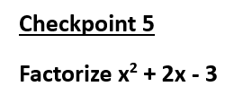
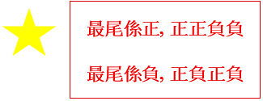

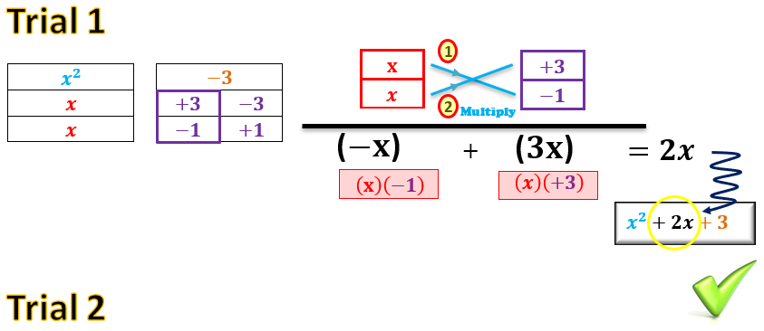
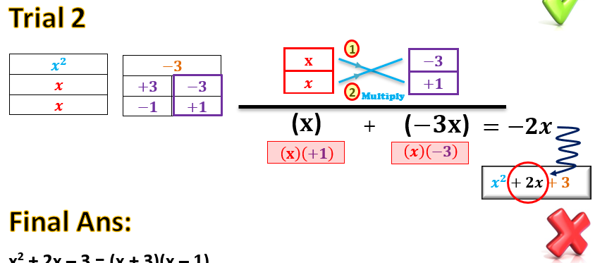
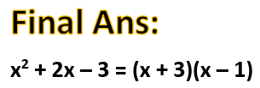

Slide 15





















































Factorize the following expressions.
61. ${−16st+s}^{2}−91t^{2}$
70. ${24α^{4}γ^{2}+90β^{4}γ}^{2}−94{α^{2}β^{2}γ}^{2}$
$$=$$
2
2
2
4
2
2
4
$$=$$
$$\text{2}γ$$
$$+$$
$$\text{45}β$$
)
$\text{s} −$16st $+$91t
(
$$\text{12}α$$
$−$ 47$α β$
$$=$$
$$+$$
2
(s
7t)
(s
$$−$$
13t)
2
2
2
2
$$=$$
$$\text{2}γ$$
($\text{4}α$
$$−$$
9$β$ )
($\text{3}α$
$$−$$
5$β$)
2
$$+$$
$$−$$
2
2
66. ${3a}^{2}−15ab−42b^{2}$
$$=$$
$$\text{2}γ$$
($\text{2}α$
3$β$)
($\text{2}α$
3$β$)
($\text{3}α$
$$−$$
5$β$)
$$=$$
$$\text{3}$$
$$+$$
($\text{a}$
$$−$$
2b)
(a
7b)
69. ${−119θφ−42θ}^{2}+98φ^{2}$
2
$$−$$
$$\text{14}φ$$
2
$$=$$
$$−\text{7}$$
(
$$\text{6}θ$$
$+$ 17$θφ$
)
$$=$$
$$−\text{7}$$
($\text{2}θ$
$$+$$
7$φ$)
($\text{3}θ$
$$−$$
2$φ$)

Slide 16














Factorize the following expressions.
6. ${−6s+s}^{2}−91$
$$=$$
2
$\text{s} −$6s $−$91
$$=$$
$$+$$
(s
7)
(s
$$−$$
13)
10. ${−17n−n}^{2}−72$
$$=$$
2
$− \text{n} −$ 17n $−$72
$$=$$
2
$−\text{(}\text{n}+$ 17n $+$72)
$$=$$
$$−$$
$$+$$
(n
(n
$$+$$
8)
9)

Slide 17



















Factorize the following expressions.
(a) ${3a}^{2}−7ac+2c^{2}$
$$=$$
$$−$$
$$−$$
(a
2c)
(3a
c)
(b) ${ 3a}^{2 } − 7ac+2c^{2} −ab+2bc$
$$=$$
$$−$$
$$−$$
$−$ab $+\text{2}\text{bc}$
$$\text{(}\text{from} \text{(}\text{a}\text{))}$$
(a
2c)
(3a
c)
$$=$$
$$−$$
$$−$$
$−$ b$\text{(}\text{a}− \text{2}\text{c}\text{)}$
(a
2c)
(3a
c)
$$=$$
$$−$$
$$−$$
(a
2c)
(3a
c $−$ b)

Slide 18







































Factorize the following expressions.
36. (a) ${x^{2}y−4xy}^{2}−32y^{3}$
2
2
$$\text{32}\text{y}$$
)
$$=$$
$$\text{y}$$
$−$ 4$\text{xy}$
(
$$\text{x}$$
$$−$$
$$=$$
$$\text{y}$$
$$+$$
($\text{x}$
$$−$$
4y)
(x
8y)
(b) ${x^{2}y+2x^{2}+16xy−4xy}^{2}+32y^{2}−32y^{3}$
$$=$$
2
2
3
2
2
$\text{x} \text{y}$ $−$4xy $−$32y
$+$ 2x $+$16xy $+$32y
$$=$$
2
2
3
2
2
$\text{x} \text{y}$ $−$4xy $−$32y
$+$ 2 (x $+$8xy $+$16y )
$$=$$
$$\text{y}$$
$$+$$
2
2
$$\text{(}\text{from} \text{(}\text{a}\text{))}$$
($\text{x}$
$$−$$
$+$ 2 [x $+$2 (x) (4y) $+$(4y) ]
4y)
(x
8y)
2
$$=$$
$$\text{y}$$
$$+$$
$+$ 2 (x $+$4y)
($\text{x}$
$$−$$
4y)
(x
8y)
$$=$$
$$+$$
($\text{x}$
4y)
[y (x $−$8y) $+$2 (x $+$4y) ]
$$=$$
$$+$$
2
($\text{x}$
4y)
(xy $−$8y $+$2x $+$8y)

Slide 19

























Factorize the following expressions.
45. $(x+3)^{3}−25x −75$
$$=$$
($\text{x}$
3
$$+$$
3)
$−$25(x $+$3)
$$=$$
($\text{x}$
2
$$+$$
3)
[(x $+$3) $−$25]
$$=$$
($\text{x}$
2
2
$$+$$
3)
[(x $+$3) $−$5 ]
$$=$$
($\text{x}$
$$+$$
3)
[(x $+$3) $+$5]
[(x $+$3) $−$5]
$$=$$
($\text{x}$
($\text{x}$
$$−$$
($\text{x}$
$$+$$
$$+$$
3)
8)
2)

Slide 20
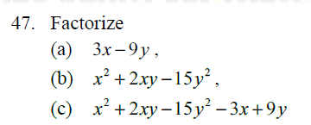




















$$=$$
3(x) $−$3(3y)
$$=$$
3(x $−$ 3y)
$$=$$
$$−$$
$$+$$
(x
3y)
(x
5y)
$$=$$
2
2
$\text{(}\text{x}$ $+$2xy $−$15y )
$−$ (3x $−$9y)
$$=$$
$$−$$
$$+$$
$−$ 3(x $−$ 3y)
$$\text{(}\text{from} \text{(}\text{a}\text{) }\text{and}\text{ (}\text{b}\text{))}$$
(x
3y)
(x
5y)
$$=$$
$$−$$
$$+$$
(x
3y)
(x
5y $−$ 3)

Slide 21
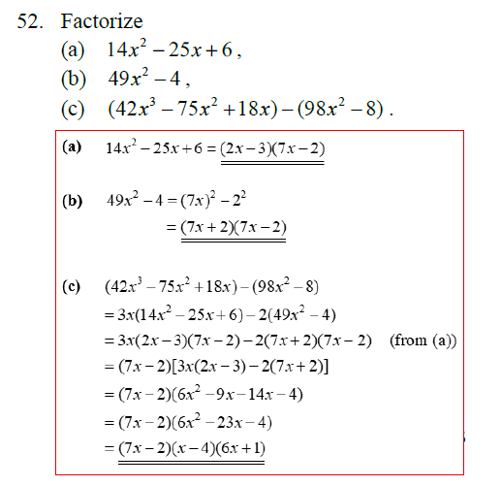










































$$=$$
$$−$$
$$−$$
(2x
3)
(7x
2)
$$=$$
2
2
(7x) $−$2
$$=$$
(7x $+$ 2) (7x $−$ 2)
$$=$$
2
2
$\text{3}\text{x} \text{(}\text{14}\text{x}$ $−$25x $+$6)
$−$ 2 (49x $−$4)
$$=$$
$$\text{3}\text{x}$$
$$−$$
$$−$$
$−$ 2 (7x $+$ 2) (7x $−$ 2)
$$\text{(}\text{from} \text{(}\text{a}\text{) }\text{and}\text{ (}\text{b}\text{))}$$
(2x
3)
(7x
2)
$$=$$
$$−$$
($\text{7}\text{x}$
$\text{2}$)
[3x (2x $−$3) $−$2 (7x $+$2)]
$$=$$
$$−$$
2
($\text{7}\text{x}$
$\text{2}$)
(6x $−$ 9x$−$ 14x$−$4)
$$=$$
$$−$$
2
($\text{7}\text{x}$
$\text{2}$)
(6x $−$ 23x $−$4)
$$=$$
$$−$$
$$+$$
($\text{7}\text{x}$
$\text{2}$)
($\text{x}$
$\text{4}$)
($\text{6}\text{x}$
$\text{1}$)
$$−$$

Slide 22
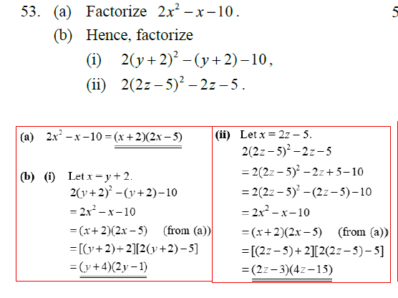































$$=$$
(x
$$+$$
2)
$$−$$
(2x
5)
(bii)
Let x$=$ 2z $−$ 5
2
(bi)
Let x$=$ y $+$ 2
$\text{2}\text{(}\text{2}\text{z}−\text{5}$) $− \text{2}\text{z}−$5
2
$$=$$
2
$\text{2}\text{(}\text{y}+$2) $− \text{(}\text{y}+$2) $−$10
$\text{2}\text{(}\text{2}\text{z}−\text{5}$) $− \text{2}\text{z}+$5 $−$ 10
$$=$$
2
$$=$$
2
$\text{2}\text{(}\text{2}\text{z}−\text{5}$) $− \text{(}\text{2}\text{z}−\text{5}$) $−$ 10
$\text{2}\text{x} − \text{x}−$10
$$=$$
2
$$=$$
(x
$$+$$
2)
$$−$$
$$\text{(}\text{from} \text{(}\text{a}\text{))}$$
$\text{2}\text{x} − \text{x}−$10
(2x
5)
$$=$$
(x
$$+$$
2)
$$−$$
$$\text{(}\text{from} \text{(}\text{a}\text{))}$$
(2x
5)
$$=$$
[(y $+$ 2) $+$ 2] [2(y $+$ 2) $−$ 5]
$$=$$
[(2z $−$ 5) $+$ 2] [2(2z $−$ 5) $−$ 5]
$$=$$
(y $+$ 4) (2y $−$ 1)
$$=$$
(2z $−$ 3) (4z $−$ 15)

Slide 23
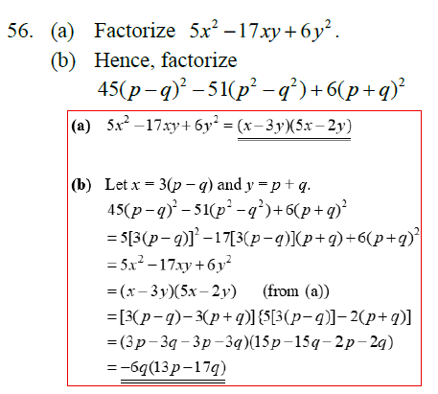























$$=$$
(x $−$ 3y) (5x $−$ 2y)
Let x$=$ 3 $\text{(}\text{p}−\text{q}$) and y$=$ $\text{p}+\text{q}$
2
2
2
2
$\text{4}\text{5}\text{(}\text{p}−\text{q}\text{)} − \text{51}\text{(}\text{p} −\text{q} \text{)}$ $+$6 $\text{(}\text{p}+\text{q}\text{)}$
2
2
$$=$$
5 [3(p $−$ q)]
$$−$$
17 [3(p $−$ q)] $\text{(}\text{p}+\text{q}\text{)}$
$+$6 $\text{(}\text{p}+\text{q}\text{)}$
$$=$$
2
2
$\text{5}\text{x} −\text{1}\text{7}\text{xy}−$6$\text{y}$
$$=$$
(x
$$−$$
3y)
$$−$$
$$\text{(}\text{from} \text{(}\text{a}\text{))}$$
(5x
2y)
$$=$$
[3 $\text{(}\text{p}−\text{q}$) $−\text{3} \text{(}\text{p}+\text{q}\text{)}$]
{5 [3 $\text{(}\text{p}−\text{q}$)] $−\text{2 }\text{(}\text{p}+\text{q}\text{)}$}
$$=$$
(3$\text{p}−\text{3}\text{q}$ $−\text{3}\text{p}−\text{3}\text{q}\text{)}$
(15$\text{p}−\text{15}\text{q}$ $−\text{2}\text{p}−\text{2}\text{q}$)
$$=$$
$$−\text{6}\text{q}$$
(13$\text{p}−\text{1}\text{7}\text{q}$)

Slide 24
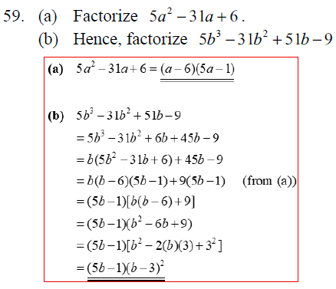

























$$=$$
(a $−$ 6) (5a $−$ 1)
$$=$$
3
2
$\text{5}\text{b} −\text{31}\text{b}+$6$\text{b}+\text{45}\text{b} −\text{9}$
$$=$$
2
$\text{b}\text{(}\text{5}\text{b} −\text{31}\text{b}+$6$\text{)}+\text{45}\text{b} −\text{9}$
$$=$$
$\text{b}$($\text{b}−\text{6}\text{)}\text{(}\text{5}\text{b}−\text{1}\text{)}$
$$+$$
$\text{9}$($\text{5}\text{b}−\text{1}$)
$$\text{(}\text{from} \text{(}\text{a}\text{))}$$
$$=$$
$$\text{(}\text{5}\text{b}−\text{1}\text{)}$$
$\text{[}\text{b}$($\text{b}−\text{6}\text{)}+\text{9}\text{]}$
2
$$=$$
$$\text{(}\text{5}\text{b}−\text{1}\text{)}$$
$$\text{(}\text{b} −\text{6}\text{b}+\text{9}\text{)}$$
2
$$+$$
2
$$=$$
$$\text{(}\text{5}\text{b}−\text{1}\text{)}$$
$$−$$
]
[
b
2
$\text{b}$)
$$\text{3}$$
(
)
(
3
2
$$=$$
$$\text{(}\text{5}\text{b}−\text{1}\text{)}$$
$$\text{(}\text{b} −\text{3}\text{)}$$

Slide 25
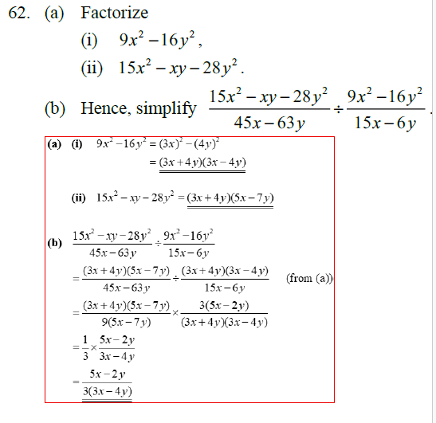

































$$=$$
2
2
(3x) $−$(4y)
$$=$$
(3x $+$ 4y) (3x $−$ 4y)
$$=$$
(3x $+$ 4y) (5x $−$ 7y)
(3x $+$ 4y) (5x $−$ 7y)
$$\text{(}\text{3}\text{x}+\text{4}\text{y}\text{) (}\text{3}\text{x} − \text{4}\text{y}\text{)}$$
$$=$$
$$÷$$
$$\text{(}\text{from} \text{(}\text{a}\text{))}$$
$$\text{45}\text{x}−\text{63}\text{y}$$
$$\text{15}\text{x}−\text{6}\text{y}$$
(3x $+$ 4y) (5x $−$ 7y)
$$\text{3}\text{(}\text{5}\text{x} − \text{2}\text{y}\text{)}$$
$$=$$
$$×$$
$$\text{3}$$
$$\text{9}\text{(}\text{5}\text{x} − \text{7}\text{y}\text{)}$$
$$\text{(}\text{3}\text{x}+\text{4}\text{y}\text{) (}\text{3}\text{x} − \text{4}\text{y}\text{)}$$
$$\text{5}\text{x}−\text{2}\text{y}$$
$$=$$
$$\text{3}\text{(}\text{3}\text{x}−\text{4}\text{y}\text{)}$$

